Slide 1
19
Viruses

Slide 2
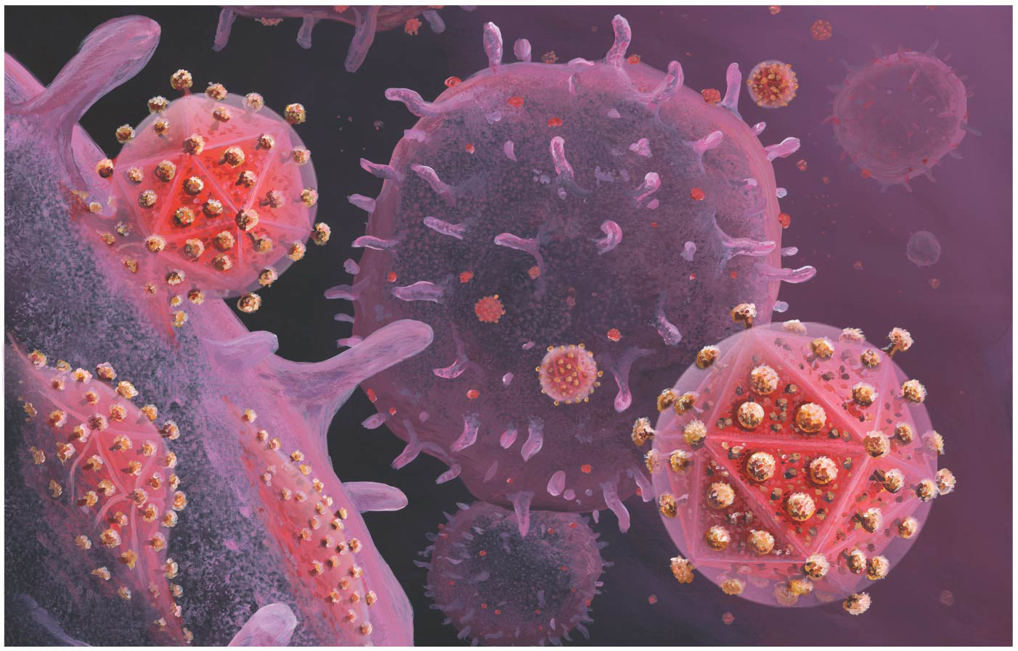
A Borrowed Life
A virus is an infectious particle consisting of genes packaged in a protein coat
Viruses are much simpler in structure than even prokaryotic cells
Viruses cannot reproduce or carry out metabolism outside of a host cell

Slide 3
Concept 19.1: A virus consists of a nucleic acid surrounded by a protein coat
Viruses were detected indirectly long before they were actually seen

Slide 4
The Discovery of Viruses: Scientific Inquiry
Tobacco mosaic disease stunts growth of tobacco plants and gives their leaves a mosaic coloration
In the late 1800s, some researchers hypothesized that a particle smaller than bacteria caused the disease
In 1935, Wendell Stanley confirmed this hypothesis by crystallizing the infectious particle, now known as tobacco mosaic virus (TMV)

Slide 5
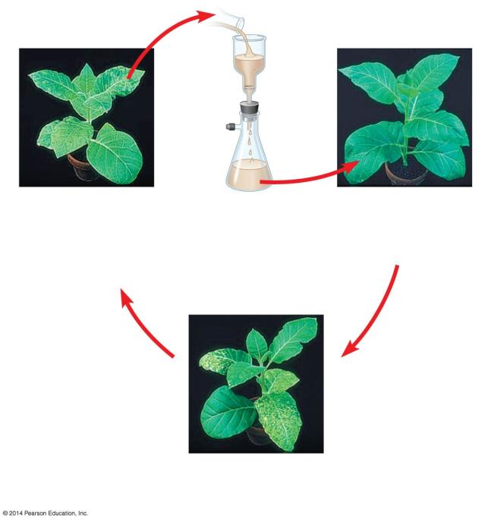
Figure 19.2
Experiment
1
Extracted sap
from tobacco
plant with
tobacco mosaic
disease
2
3
Passed sap
through a
porcelain filter
known to trap
bacteria
Rubbed filtered
sap on healthy
tobacco plants
4
Healthy plants
became infected
Notes:
Figure 19.2 Inquiry: What causes tobacco mosaic disease?

Slide 6
Structure of Viruses
Viruses are not cells
A virus is a very small infectious particle consisting of nucleic acid enclosed in a protein coat and, in some cases, a membranous envelope

Slide 7
Viral Genomes
Viral genomes may consist of either
Double- or single-stranded DNA, or
Double- or single-stranded RNA
Depending on its type of nucleic acid, a virus is called a DNA virus or an RNA virus
The genome is either a single linear or circular molecule of the nucleic acid
Viruses have between three and several thousand genes in their genome

Slide 8
Capsids and Envelopes
A capsid is the protein shell that encloses the viral genome
Capsids are built from protein subunits called capsomeres
A capsid can have a variety of structures

Slide 9
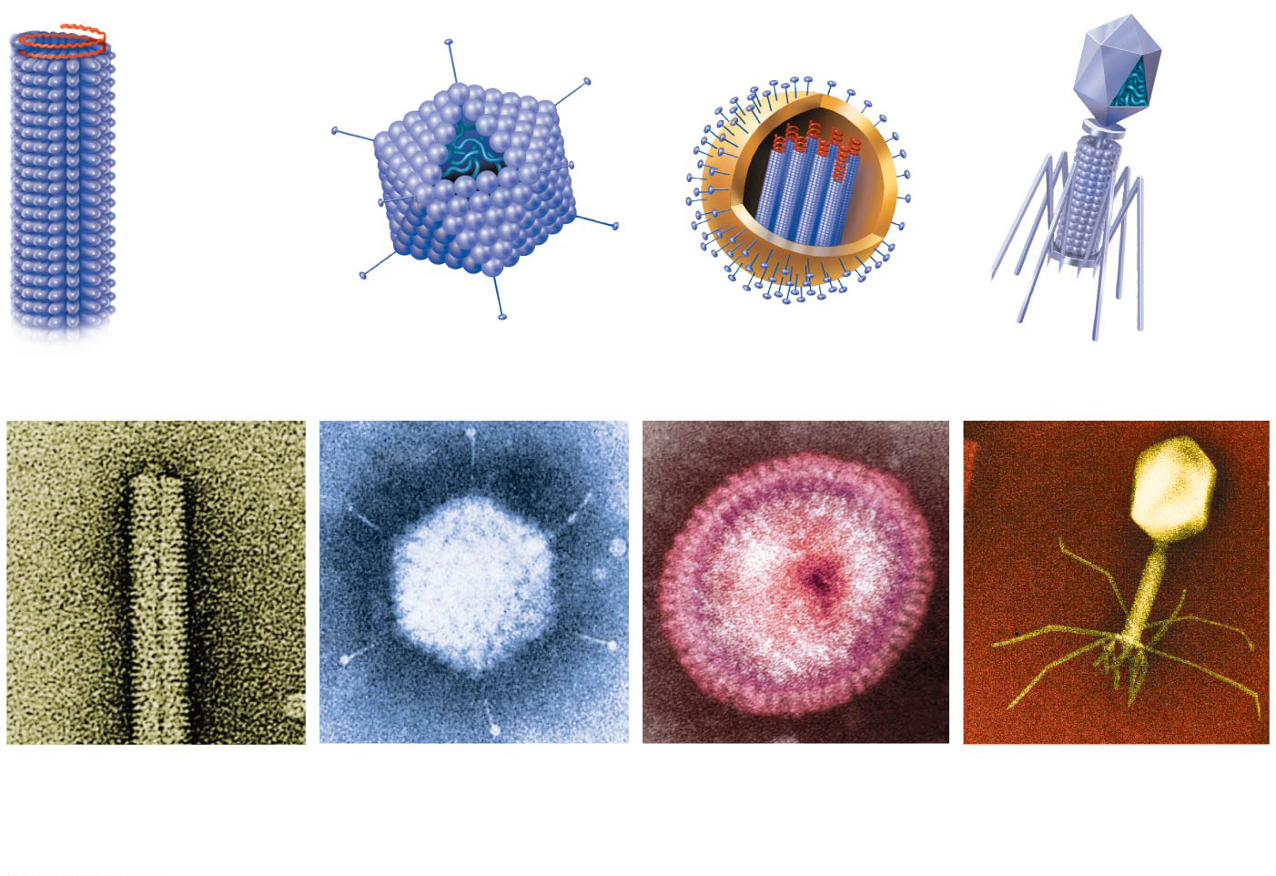
Figure 19.3
RNA
Membranous
envelope
RNA
Head
Capsomere
DNA
Capsid
DNA
Capsomere
of capsid
Tail
sheath
Tail
fiber
Glycoprotein
Glycoproteins
18 × 250 nm
70–90 nm (diameter)
80–200 nm (diameter)
80 × 225 nm
20 nm
50 nm
50 nm
50 nm
(a)
Tobacco mosaic
virus
(b)
Adenoviruses
(c)
Influenza viruses
(d)
Bacteriophage T4
Notes:
Figure 19.3 Viral structure

Slide 10
Some viruses have accessory structures that help them infect hosts
Viral envelopes (derived from membranes of host cells) surround the capsids of influenza viruses and many other viruses found in animals
Viral envelopes contain a combination of viral and host cell molecules

Slide 11
Bacteriophages, also called phages, are viruses that infect bacteria
They have the most complex capsids found among viruses
Phages have an elongated capsid head that encloses their DNA
A protein tail piece attaches the phage to the host and injects the phage DNA inside

Slide 12
Concept 19.2: Viruses replicate only in host cells
Viruses are obligate intracellular parasites, which means they can replicate only within a host cell
Each virus has a host range, a limited number of host cells that it can infect

Slide 13
General Features of Viral Replicative Cycles
Once a viral genome has entered a cell, the cell begins to manufacture viral proteins
The virus makes use of host enzymes, ribosomes, tRNAs, amino acids, ATP, and other molecules
Viral nucleic acid molecules and capsomeres spontaneously self-assemble into new viruses

Slide 14
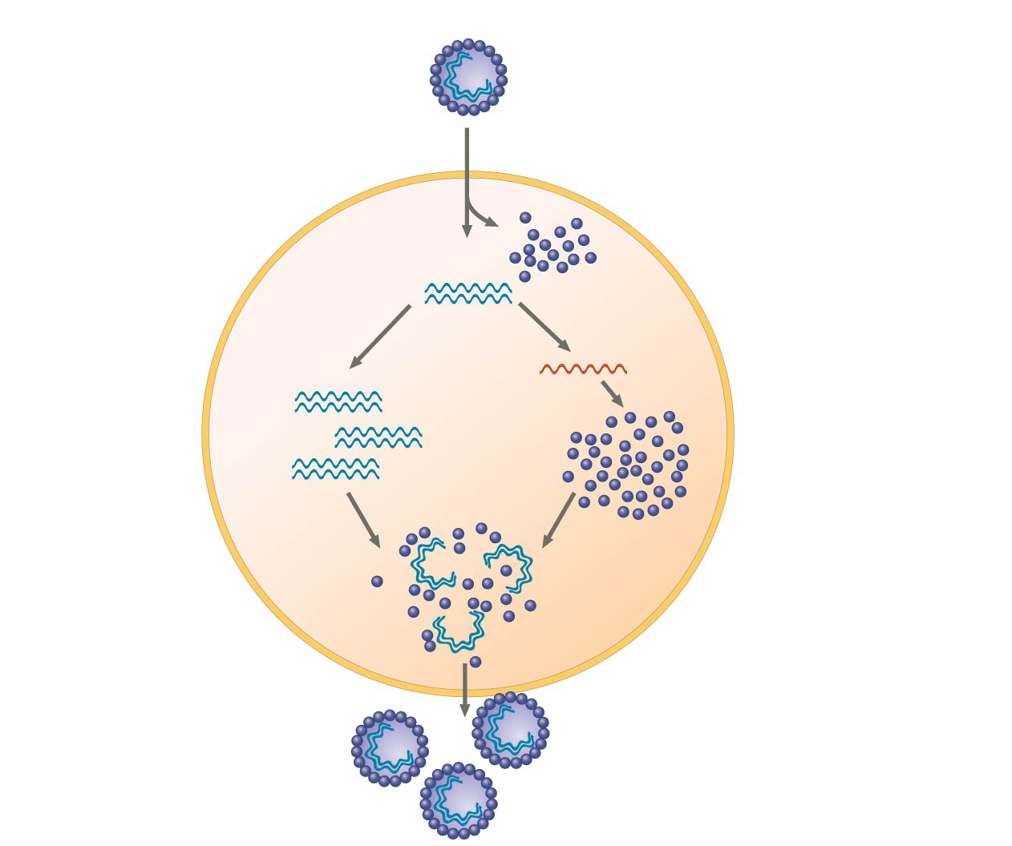
Figure 19.4
VIRUS
DNA
3
Transcription and
manufacture of
capsid proteins
Capsid
1
Entry and
uncoating
HOST
CELL
2
Replication
Viral DNA
mRNA
Viral DNA
Capsid
proteins
4
Self-assembly of
new virus particles
and their exit from
the cell
Notes:
Figure 19.4 A simplified viral replicative cycle

Slide 15
Replicative Cycles of Phages
Phages are the best understood of all viruses
Phages have two alternative reproductive mechanisms: the lytic cycle and the lysogenic cycle

Slide 16
The Lytic Cycle
The lytic cycle is a phage replicative cycle that culminates in the death of the host cell
The lytic cycle produces new phages and lyses (breaks open) the host’s cell wall, releasing the progeny viruses
A phage that reproduces only by the lytic cycle is called a virulent phage
Bacteria have defenses against phages, including restriction enzymes that recognize and cut up certain phage DNA

Slide 17
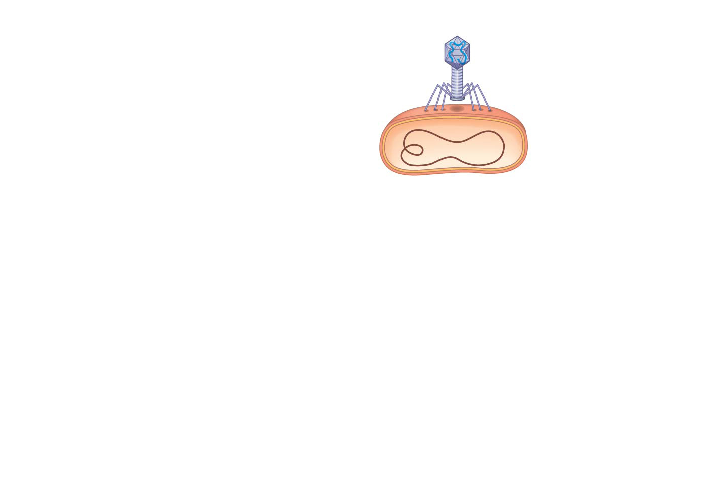
Figure 19.5-1
1
Attachment
Notes:
Figure 19.5-1 The lytic cycle of phage T4, a virulent phage (step 1)

Slide 18
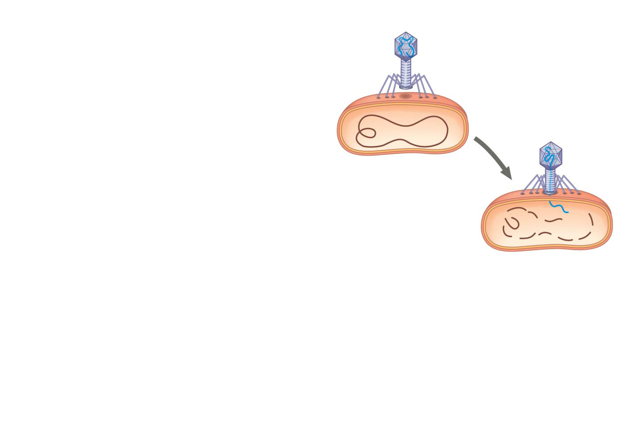
Figure 19.5-2
1
Attachment
2
Entry of phage
DNA and
degradation
of host DNA
Notes:
Figure 19.5-2 The lytic cycle of phage T4, a virulent phage (step 2)

Slide 19
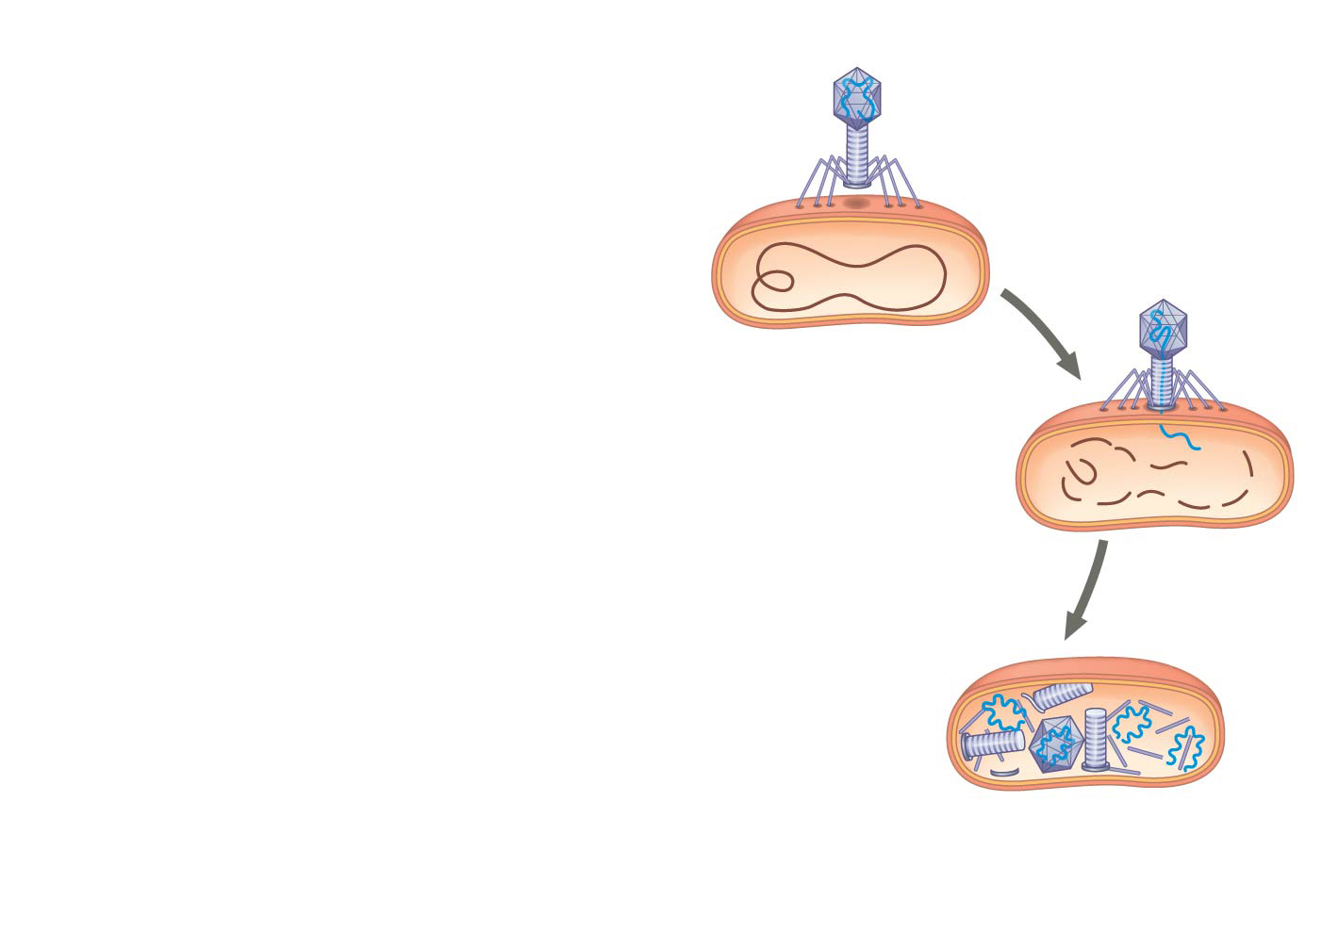
Figure 19.5-3
1
Attachment
2
Entry of phage
DNA and
degradation
of host DNA
3
Synthesis of viral
genomes and
proteins
Notes:
Figure 19.5-3 The lytic cycle of phage T4, a virulent phage (step 3)

Slide 20
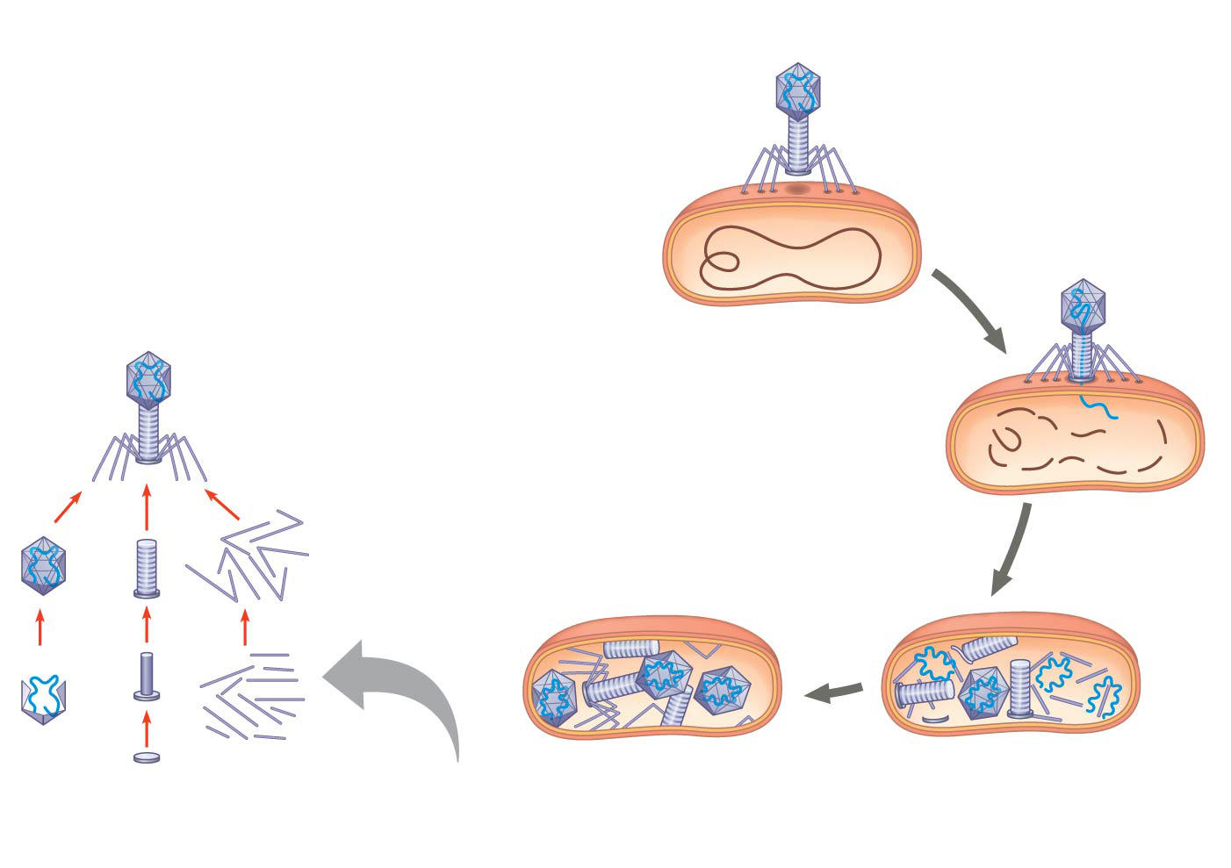
Figure 19.5-4
1
Attachment
2
Entry of phage
DNA and
degradation
of host DNA
Phage assembly
3
Synthesis of viral
genomes and
proteins
Head
Tail
Tail
fibers
4
Self-assembly
Notes:
Figure 19.5-4 The lytic cycle of phage T4, a virulent phage (step 4)

Slide 21
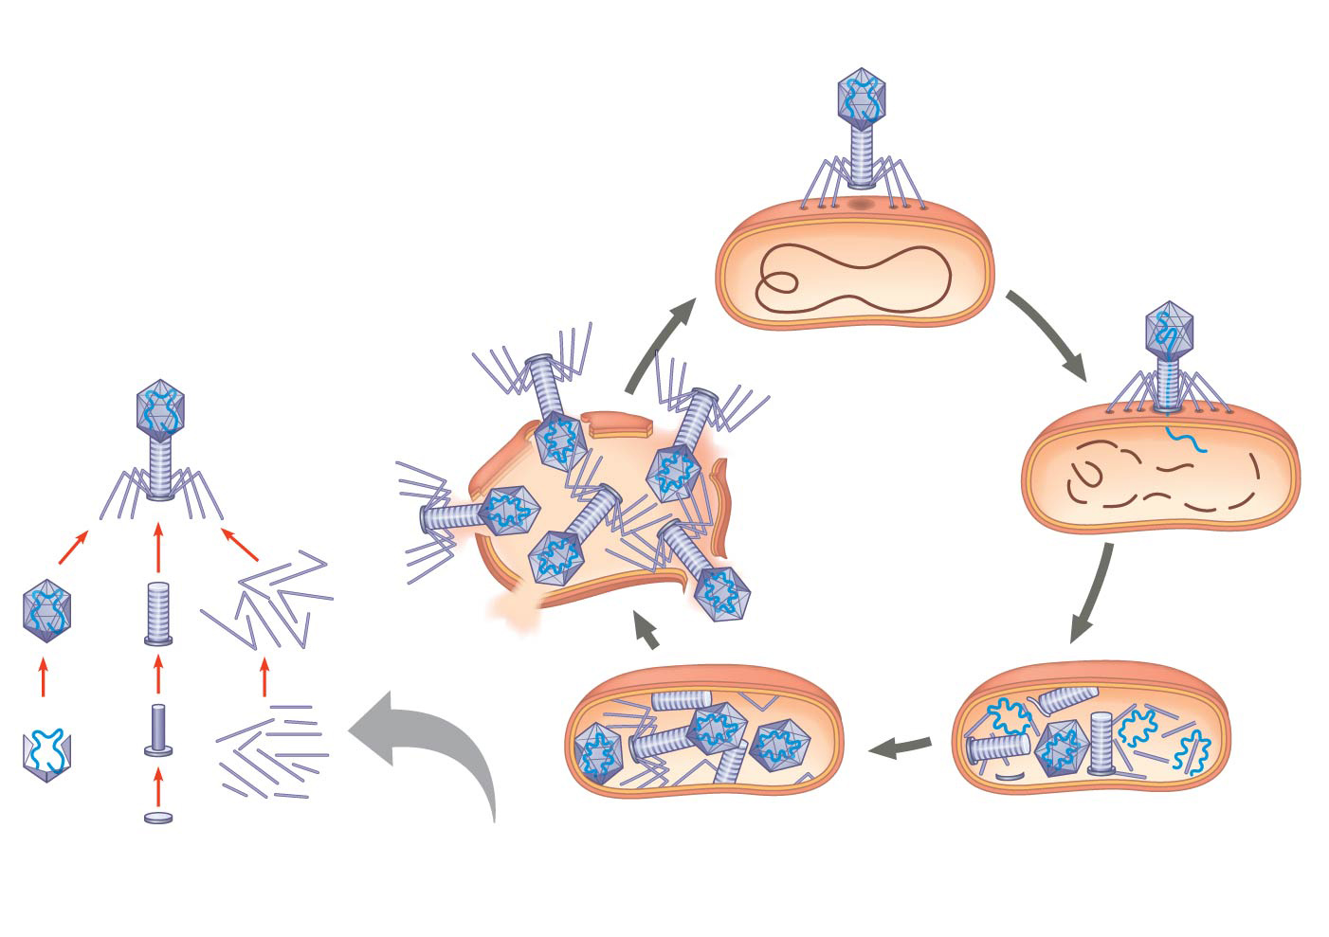
Figure 19.5-5
1
Attachment
2
Entry of phage
DNA and
degradation
of host DNA
5
Release
Phage assembly
3
Synthesis of viral
genomes and
proteins
Head
Tail
Tail
fibers
4
Self-assembly
Notes:
Figure 19.5-5 The lytic cycle of phage T4, a virulent phage (step 5)

Slide 22
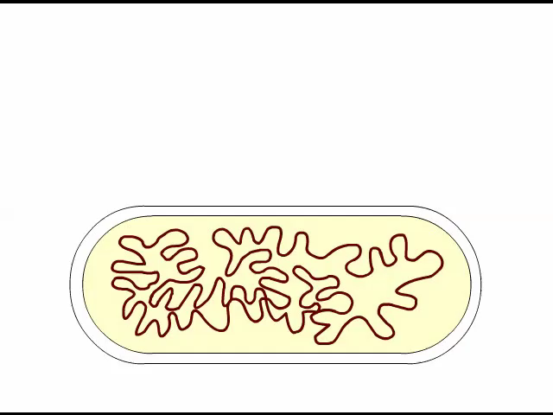
Animation: Phage T4 Lytic Cycle

Slide 23
The Lysogenic Cycle
The lysogenic cycle replicates the phage genome without destroying the host
The viral DNA molecule is incorporated into the host cell’s chromosome
This integrated viral DNA is known as a prophage
Every time the host divides, it copies the phage DNA and passes the copies to daughter cells

Slide 24
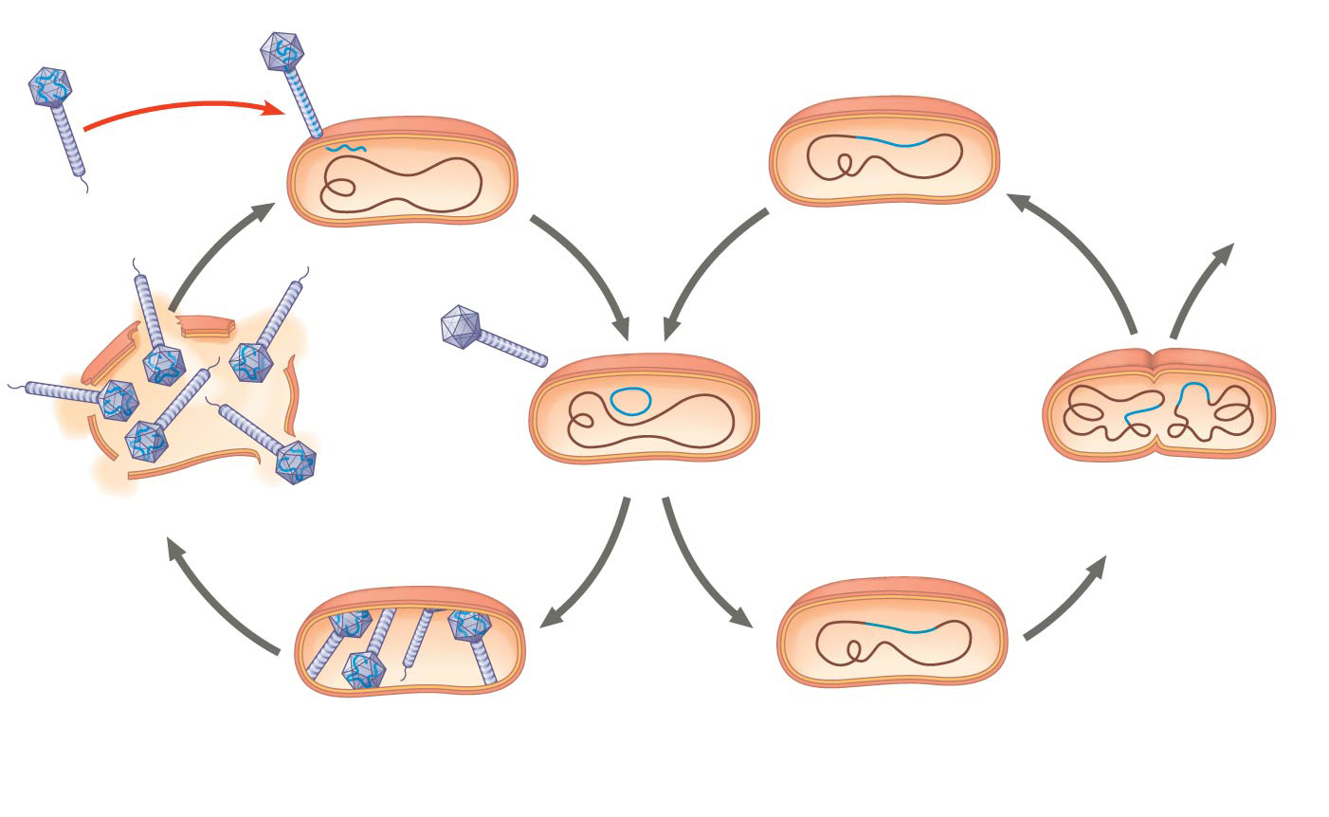
Figure 19.6
Phage
DNA
Daughter cell
with prophage
The phage injects its DNA.
Many cell
divisions
create many
infected
bacteria.
Tail fiber
Phage DNA
circularizes.
Phage
Bacterial
chromosome
Prophage exits
chromosome.
Lytic
cycle
Lysogenic
cycle
Prophage is copied
with bacterial
chromosome.
The cell lyses,
releasing
phages.
Prophage
Phage DNA and proteins
are synthesized and
assembled.
Phage DNA integrates
into bacterial
chromosome.
Notes:
Figure 19.6 The lytic and lysogenic cycles of phage λ, a temperate phage

Slide 25
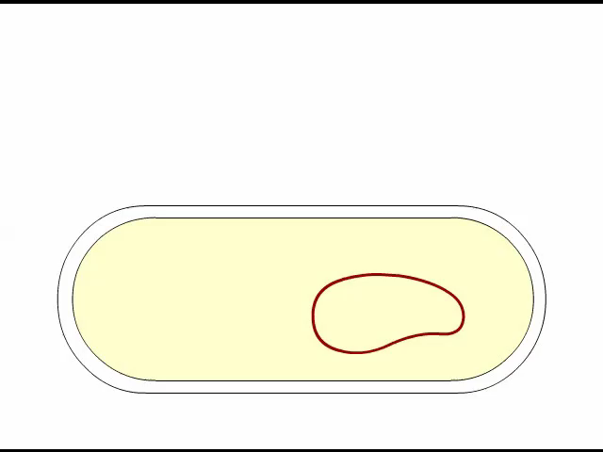
Animation: Phage Lambda Lysogenic and Lytic Cycles

Slide 26
An environmental signal can trigger the virus genome to exit the bacterial chromosome and switch to the lytic mode
Phages that use both the lytic and lysogenic cycles are called temperate phages

Slide 27
Replicative Cycles of Animal Viruses
There are two key variables used to classify viruses that infect animals
An RNA or DNA genome
A single-stranded or double-stranded genome
Whereas few bacteriophages have an envelope or an RNA genome, many animal viruses have both

Slide 28
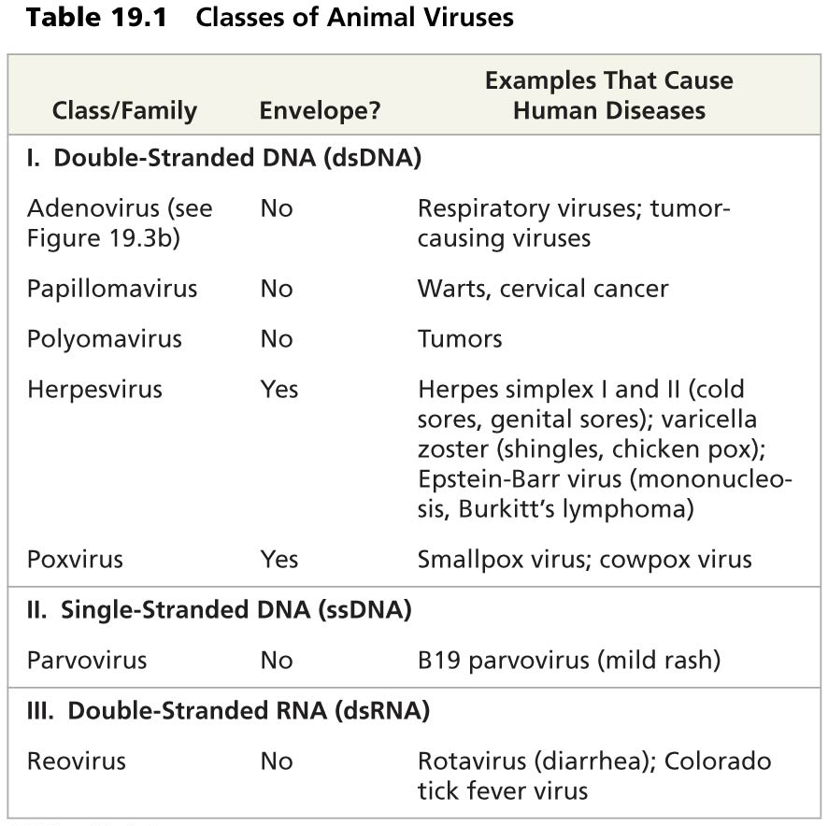
Table 19.1a
Notes:
Table 19.1a Classes of animal viruses (part 1)

Slide 29
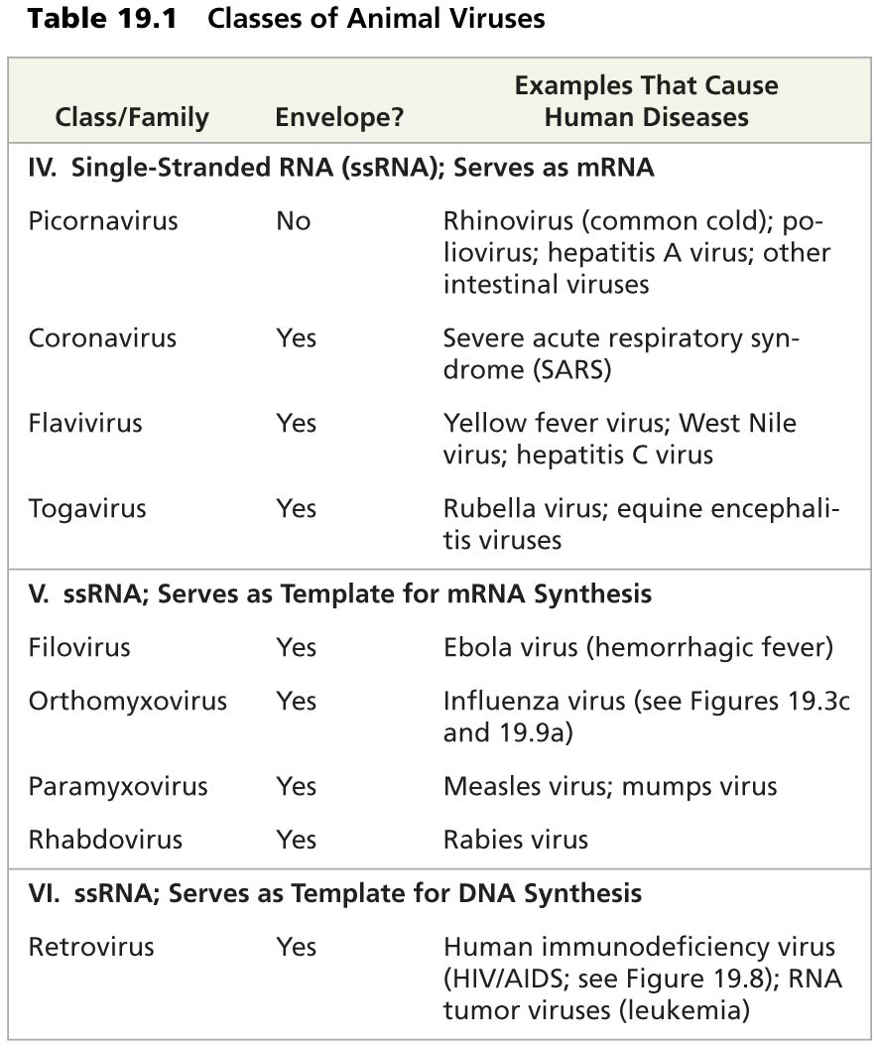
Table 19.1b
Notes:
Table 19.1b Classes of animal viruses (part 2)

Slide 30
Viral Envelopes
Many viruses that infect animals have a membranous envelope
Viral glycoproteins on the envelope bind to specific receptor molecules on the surface of a host cell
Some viral envelopes are derived from the host cell’s plasma membrane as the viral capsids exit

Slide 31
Other viral membranes form from the host’s nuclear envelope and are then replaced by an envelope made from Golgi apparatus membrane

Slide 32
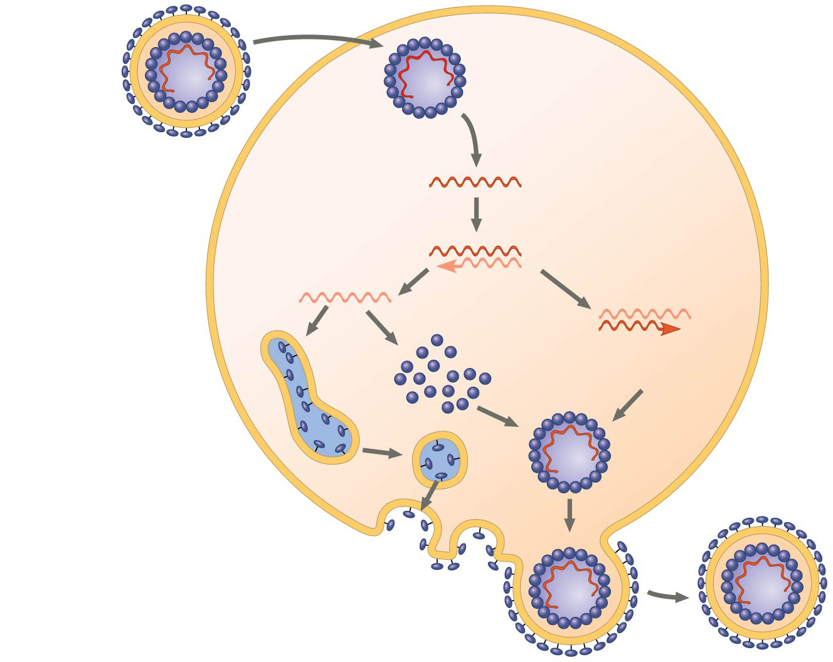
Figure 19.7
Capsid
RNA
HOST CELL
Envelope (with
glycoproteins)
Viral genome
(RNA)
Template
mRNA
Capsid
proteins
Copy of
genome
(RNA)
ER
Glyco-
proteins
New virus
Notes:
Figure 19.7 The replicative cycle of an enveloped RNA virus

Slide 33
RNA as Viral Genetic Material
The broadest variety of RNA genomes is found in viruses that infect animals
Retroviruses use reverse transcriptase to copy their RNA genome into DNA
HIV (human immunodeficiency virus) is the retrovirus that causes AIDS (acquired immunodeficiency syndrome)

Slide 34
The viral DNA that is integrated into the host genome is called a provirus
Unlike a prophage, a provirus remains a permanent resident of the host cell
RNA polymerase transcribes the proviral DNA into RNA molecules
The RNA molecules function both as mRNA for synthesis of viral proteins and as genomes for new virus particles released from the cell

Slide 35
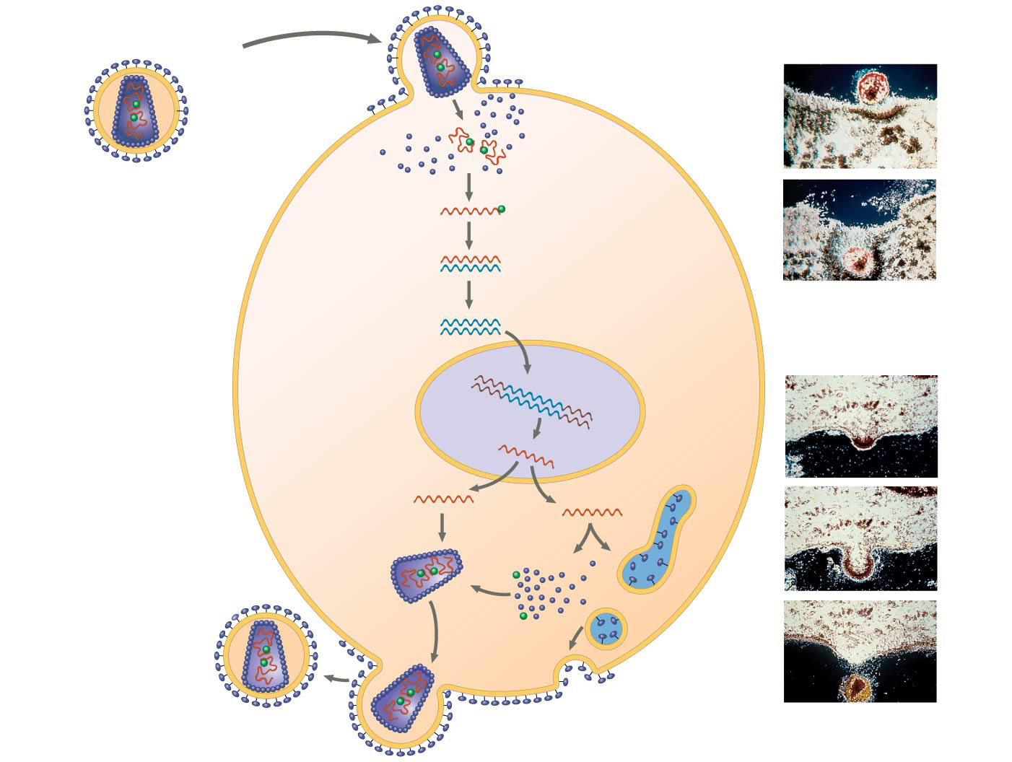
Figure 19.8
Glycoprotein
Viral envelope
Membrane of
white blood cell
HIV
Capsid
RNA (two
identical
strands)
HOST
CELL
HIV
Reverse
transcriptase
Reverse
transcriptase
Viral RNA
RNA-DNA
hybrid
0.25 µm
DNA
HIV entering a cell
NUCLEUS
Provirus
Chromosomal
DNA
RNA genome
for the progeny
viruses
mRNA
New virus
New HIV leaving
a cell
Notes:
Figure 19.8 The replicative cycle of HIV, the retrovirus that causes AIDS

Slide 36
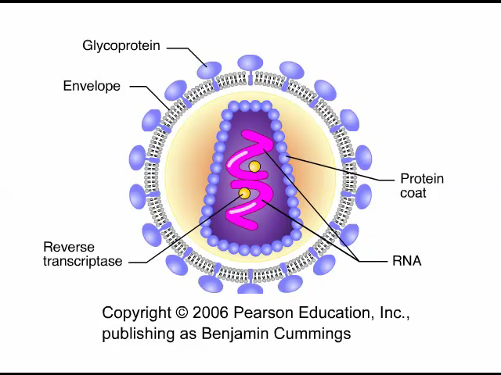
Animation: HIV Reproductive Cycle

Slide 37
Evolution of Viruses
Viruses do not fit our definition of living organisms
Since viruses can replicate only within cells, they probably evolved as bits of cellular nucleic acid
Candidates for the source of viral genomes include plasmids and transposons
Plasmids, transposons, and viruses are all mobile genetic elements

Slide 38
The largest virus yet discovered is the size of a small bacterium, and its genome encodes proteins involved in translation, DNA repair, protein folding, and polysaccharide synthesis
There is controversy about whether this virus evolved before or after cells

Slide 39
Concept 19.3: Viruses, viroids, and prions are formidable pathogens in animals and plants
Diseases caused by viral infections affect humans, agricultural crops, and livestock worldwide
Smaller, less complex entities called viroids and prions also cause disease in plants and animals, respectively

Slide 40
Viral Diseases in Animals
Viruses may damage or kill cells by causing the release of hydrolytic enzymes from lysosomes
Some viruses cause infected cells to produce toxins that lead to disease symptoms
Others have molecular components such as envelope proteins that are toxic

Slide 41
Vaccines are harmless derivatives of pathogenic microbes that stimulate the immune system to mount defenses against the harmful pathogen
Vaccines can prevent certain viral illnesses
Viral infections cannot be treated by antibiotics
Antiviral drugs can help to treat, though not cure, viral infections

Slide 42
Emerging Viruses
Emerging viruses are those that suddenly become apparent
In 2009, a general outbreak (epidemic) of a flu-like illness appeared in Mexico and the United States, caused by an influenza virus named H1N1
Flu epidemics are caused by new strains of influenza virus to which people have little immunity

Slide 43
Viral diseases in a small isolated population can emerge and become global
New viral diseases can emerge when viruses spread from animals to humans
Viral strains that jump species can exchange genetic information with other viruses to which humans have no immunity

Slide 44
These strains can cause pandemics, global epidemics
The 2009 flu pandemic was likely passed to humans from pigs; for this reason it was originally called the “swine flu”

Slide 45
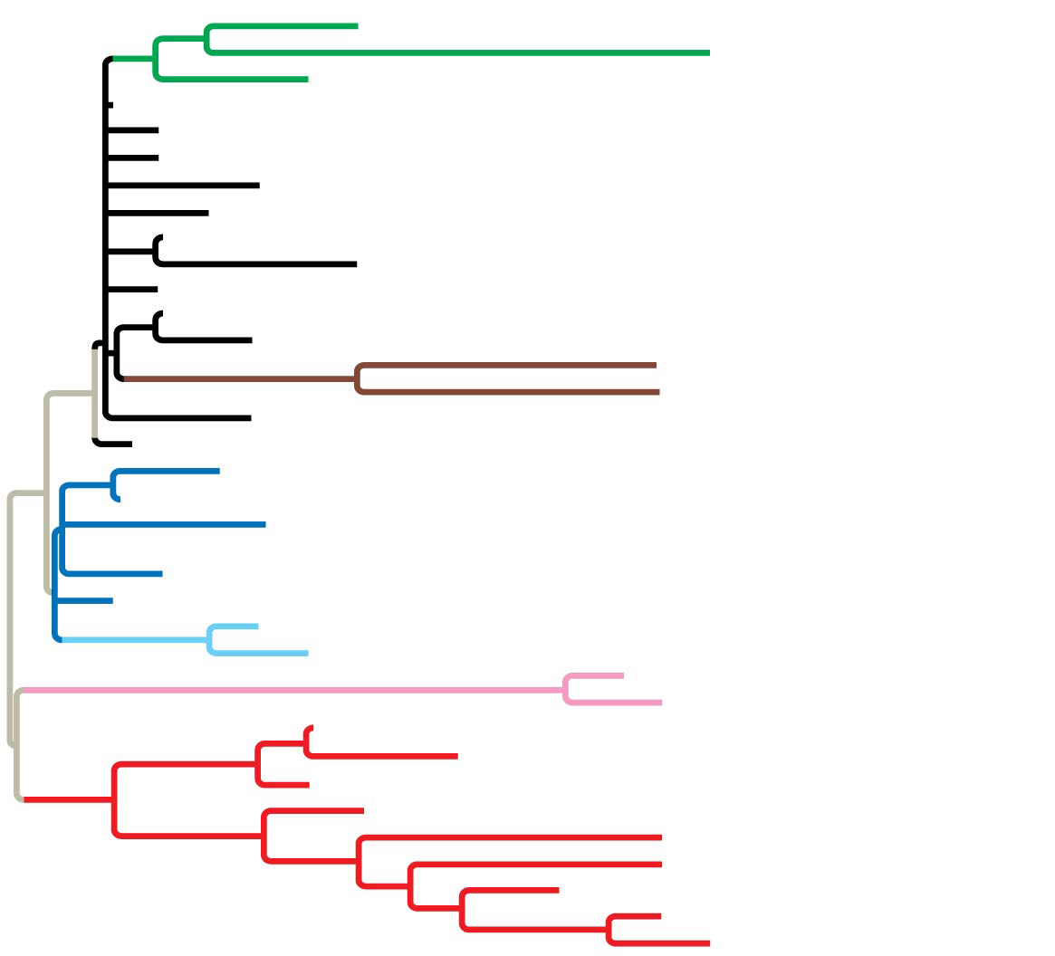
A/California/07/2009
Group 1
A/Taiwan/1164/2010
Group 3
A/Taiwan/T1773/2009
Group 6
A/Taiwan/T1338/2009
A/Taiwan/T0724/2009
A/Taiwan/T1821/2009
A/Taiwan/937/2009
A/Taiwan/T1339/2009
Group 7
A/Taiwan/940/2009
A/Taiwan/7418/2009
A/Taiwan/8575/2009
A/Taiwan/4909/2009
A/Taiwan/8542/2009
A/Taiwan/1018/2011
Group 9
A/Taiwan/552/2011
A/Taiwan/2826/2009
A/Taiwan/T0826/2009
A/Taiwan/1017/2009
A/Taiwan/7873/2009
A/Taiwan/11706/2009
Group 8
A/Taiwan/6078/2009
A/Taiwan/6341/2009
A/Taiwan/6200/2009
A/Taiwan/5270/2010
Group 8-1
A/Taiwan/3994/2010
A/Taiwan/2649/2011
Group 10
A/Taiwan/1102/2011
A/Taiwan/4501/2011
A/Taiwan/67/2011
A/Taiwan/1749/2011
A/Taiwan/4611/2011
A/Taiwan/5506/2011
Group 11
A/Taiwan/1150/2011
A/Taiwan/2883/2011
A/Taiwan/842/2010
A/Taiwan/3697/2011
Notes:
Figure 19.UN01a Skills exercise: analyzing a sequence-based phylogenetic tree to understand viral evolution (part 1)

Slide 46
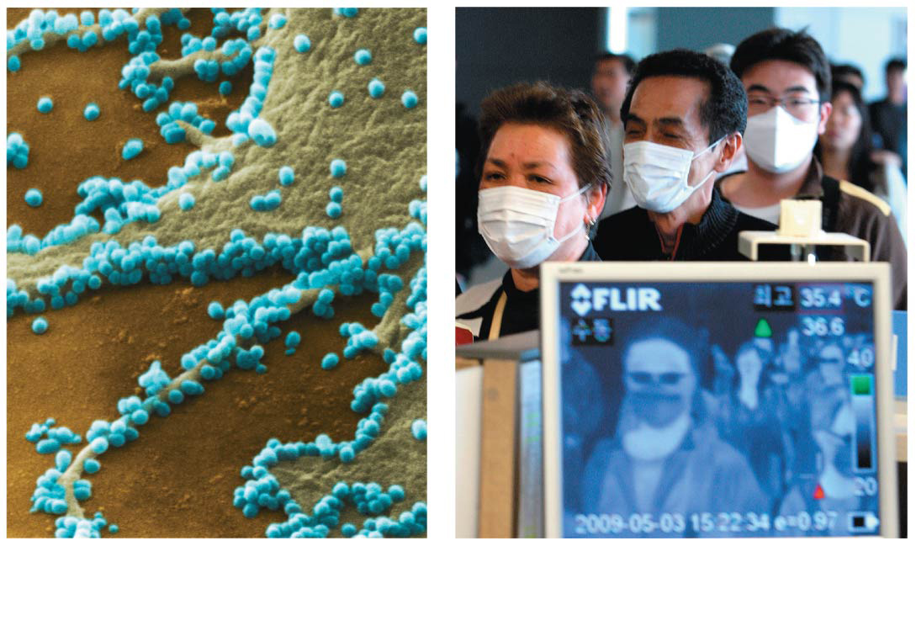
Figure 19.9
1 µm
(a)
2009 pandemic H1N1
influenza A virus
(b)
2009 pandemic screening
Notes:
Figure 19.9 Influenza in humans

Slide 47
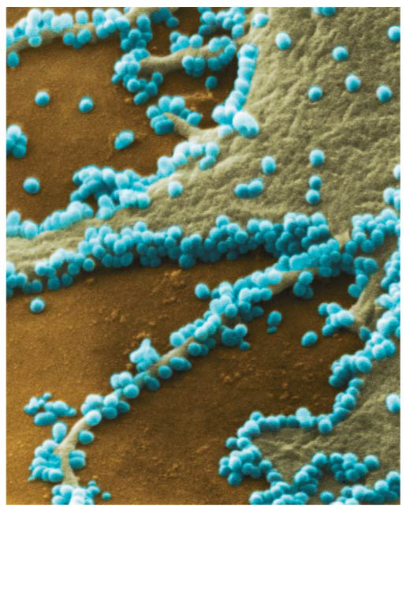
Figure 19.9a
1 µm
(a)
2009 pandemic H1N1
influenza A virus
Notes:
Figure 19.9a Influenza in humans (part 1: SEM)

Slide 48
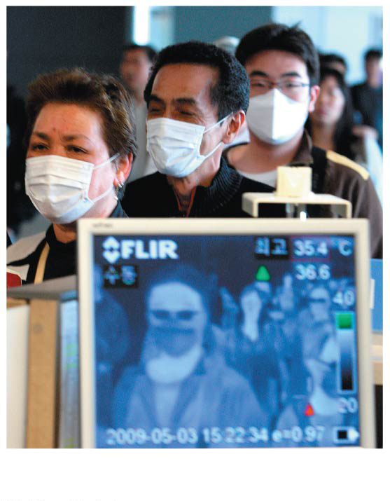
Figure 19.9b
(b)
2009 pandemic screening
Notes:
Figure 19.9b Influenza in humans (part 2: screening)

Slide 49
Viral Diseases in Plants
More than 2,000 types of viral diseases of plants are known and cause spots on leaves and fruits, stunted growth, and damaged flowers or roots
Most plant viruses have an RNA genome
Many have a helical capsid, while others have an icosahedral capsid

Slide 50
Plant viruses spread disease in two major modes
Horizontal transmission, entering through damaged cell walls
Vertical transmission, inheriting the virus from a parent

Slide 51
Viroids and Prions: The Simplest Infectious Agents
Viroids are small circular RNA molecules that infect plants and disrupt their growth
Prions are slow-acting, virtually indestructible infectious proteins that cause brain diseases in mammals
Prions propagate by converting normal proteins into the prion version
Scrapie in sheep, mad cow disease, and Creutzfeldt-Jakob disease in humans are all caused by prions

Slide 52
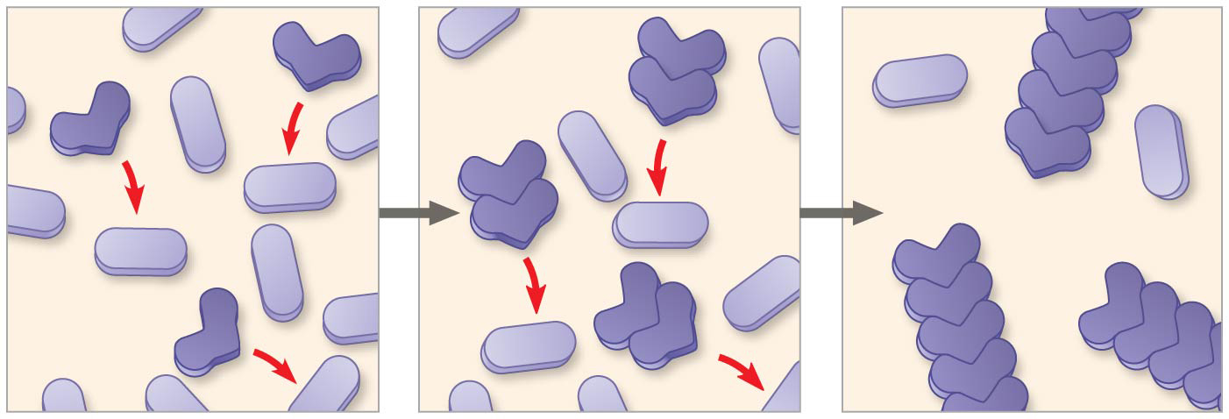
Figure 19.10
Prion
Original
prion
Aggregates
of prions
New
prion
Normal
protein
Notes:
Figure 19.10 Model for how prions propagate

